Slide 1
Golfy McGpsFace
GPS-based distance calculator

Slide 2
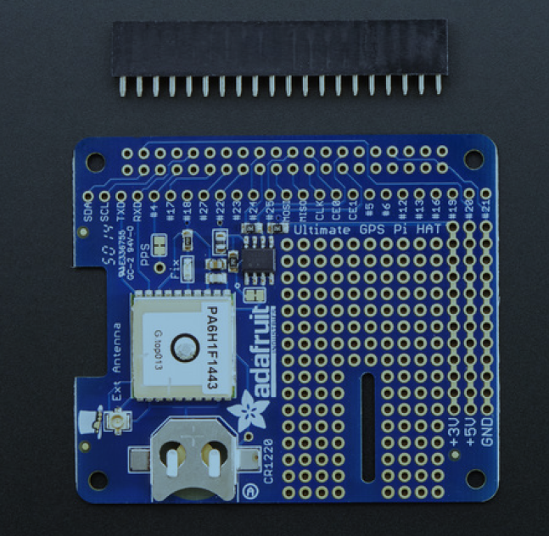
Solder the GPIO header to the bottom side of the circuit board.
This allows you to plug the GPS hat onto the top of the RPI with the boards matching up

Slide 3
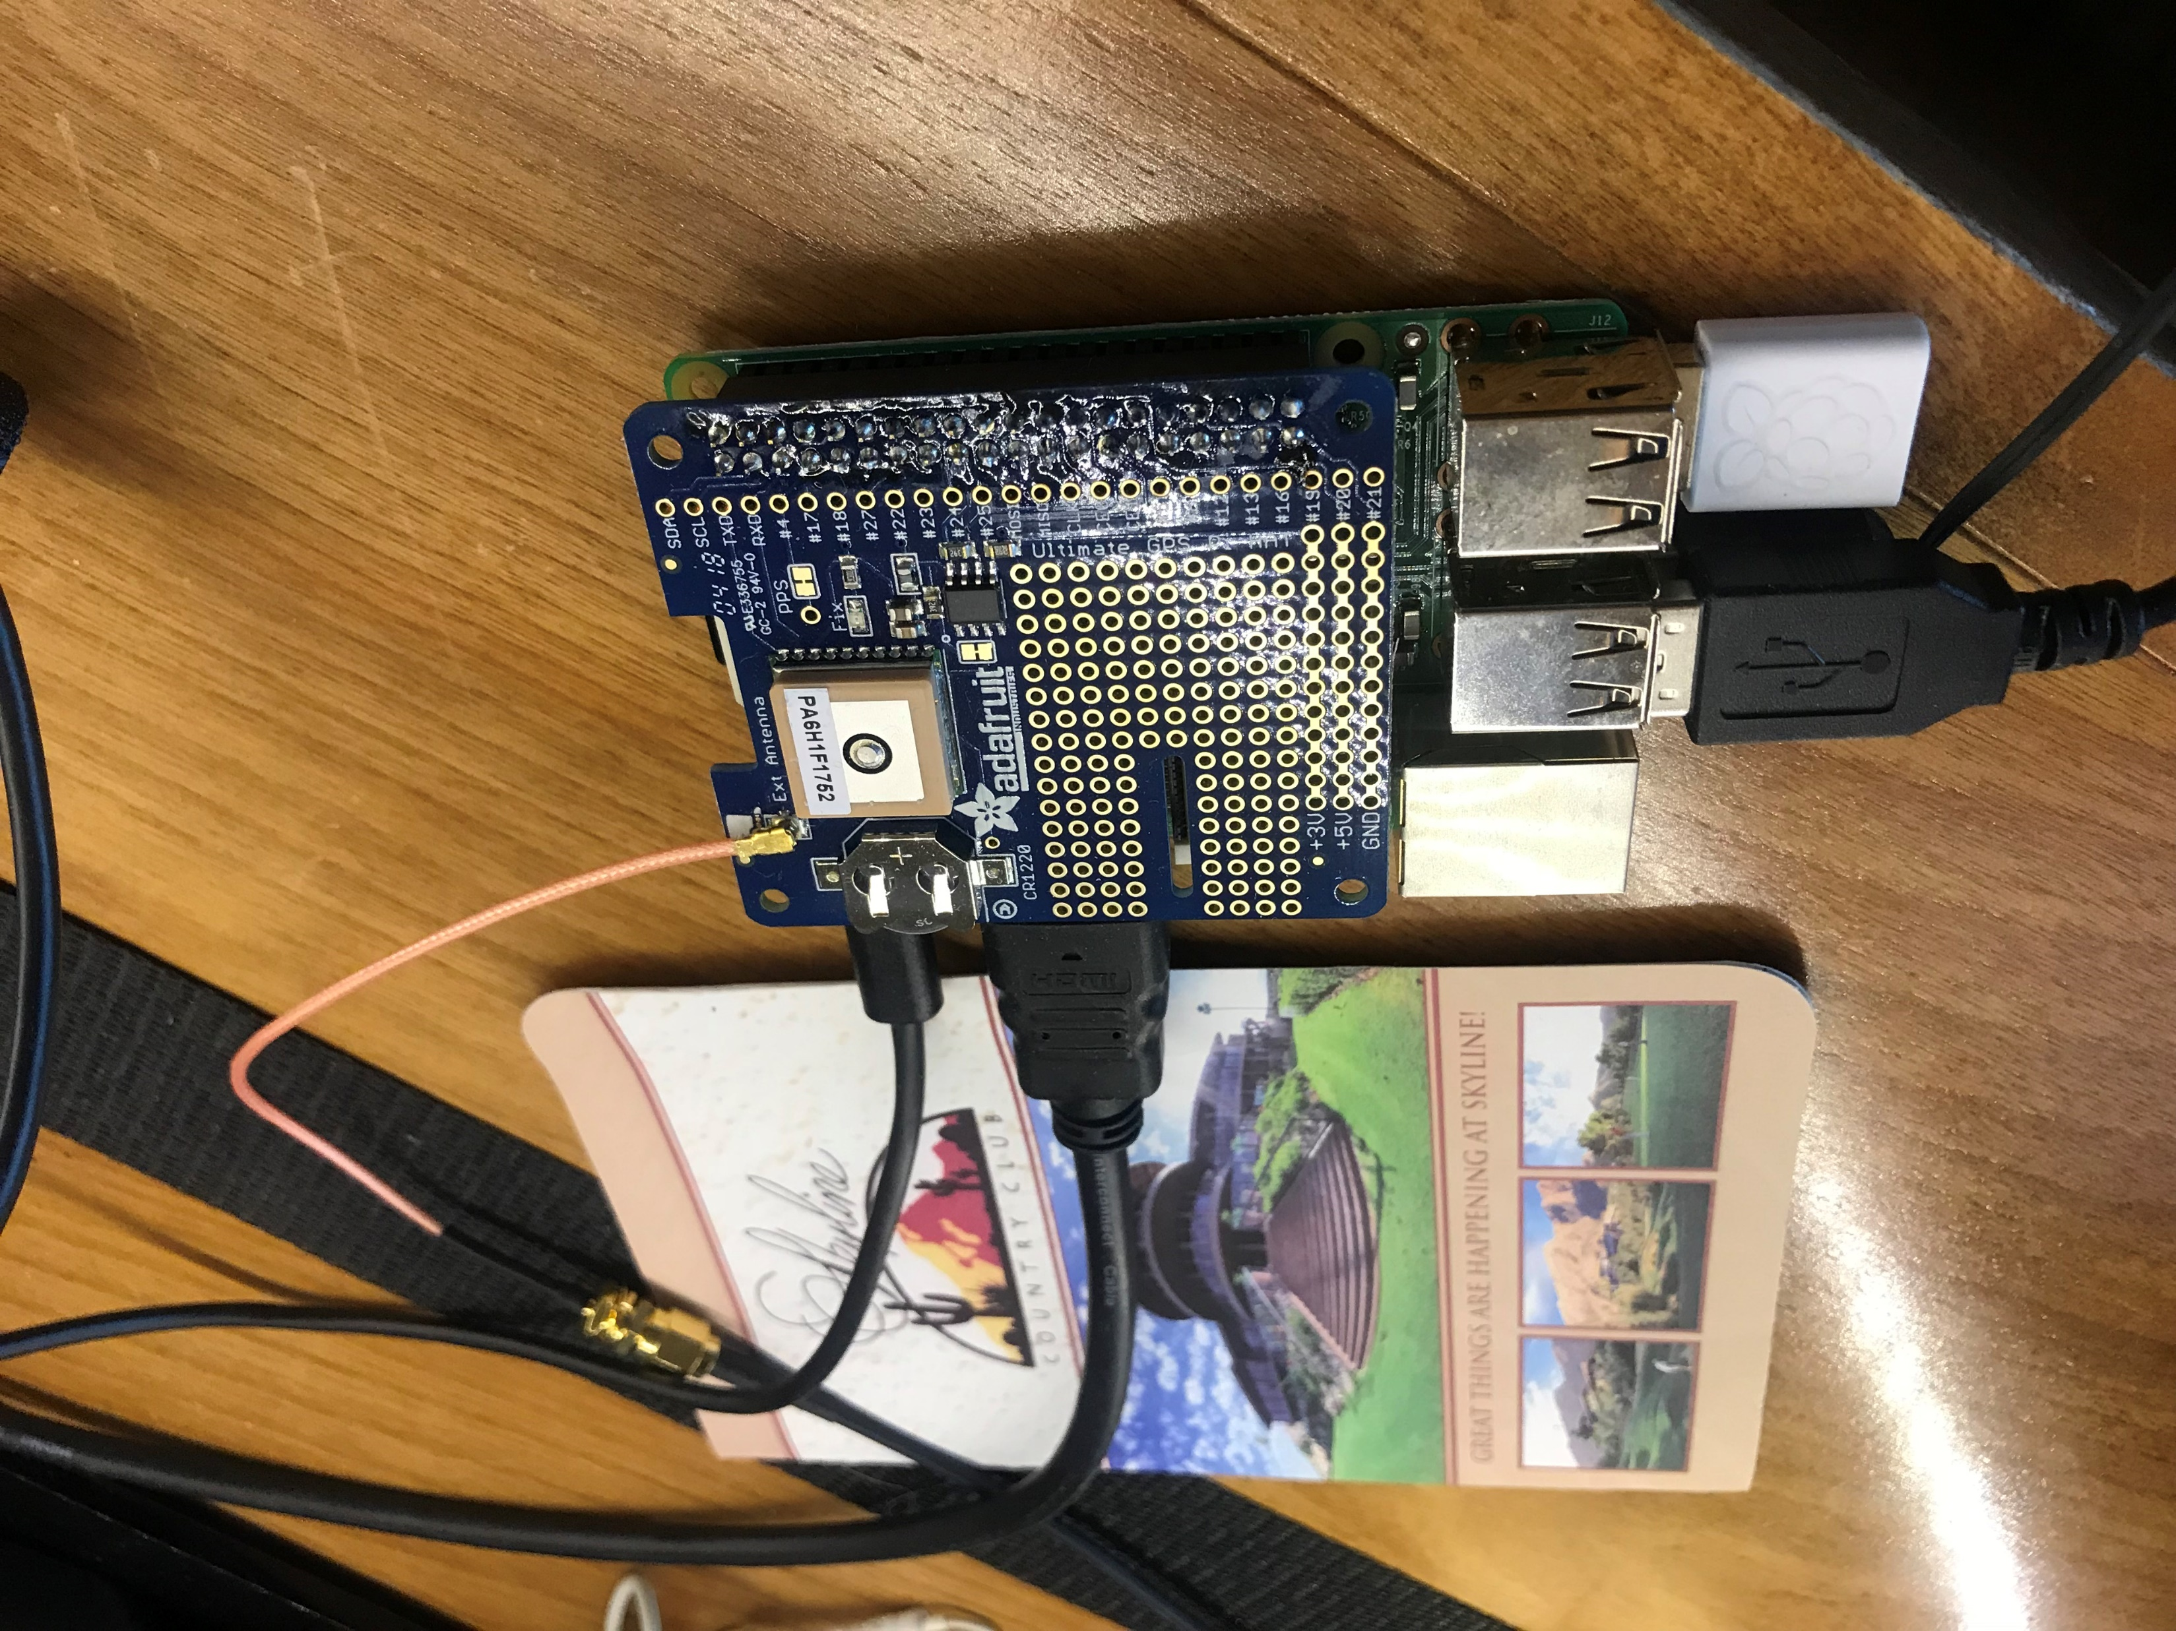
This image shows the GPS hat plugged onto the RPI
It also shows that I used the external antenna extender (orange colored cable at top right of board in picture
There is also an HDMI monitor connection, USB keyboard and USB mouse
Since it is a Raspberry Pi 2, there was also the need for a USB WIFI device

Slide 4
Parts List
Purchased from Adafruit web-site
CR1220 12mm Diameter – 3V Lithium coin cell battery
GPS Antenna – External Active Antenna - 3-5V 28dB, 5 meter
SMA to uFL/u.FL/IPX/IPEX RF Adapter Cable
Adafruit Ultimate GPS HAT for Raspberry Pi 2
GPIO Header for Raspberry Pi HAT - 2x20 Short Female Header
Miscellaneous parts
Raspberry Pi 2
USB keyboard
USB mouse
USB Wifi dongle (compatible with Windows IoT)

Slide 5
App Notes
The entire application, including Windows IoT core, crashed often in early development.
Internet research lead to not providing enough power to the RPI and GPS HAT.
Needed replace the default power supply that comes with the RPI2 with one that provided more amperage.
Not sure the amperage need but used an externally powered USB device with up to 8 amps. I would guess it needs around 2.5 amps.
Even with more power, the build crashes periodically and was unable to fully debug the root cause.
I think it is related to the generation RPI that I am using. I cannot get a recent build of the Windows IoT core to boot. This is why an older build is used here (14393)

